Slide 1
Accessing the Curriculum for Diverse Learners
Task Analysis

Slide 2

Activity: How to do…

Slide 3


Slide 4
Task Analysis
Developed in the 1970’s
First introduced as a “technology” or system to teach individuals with intellectual disabilities how to do vocational and domestic skills
Significant in demonstrating that individuals with intellectual disabilities can learn, when tasks and supports are presented appropriately
Now used for teaching skills to people of diverse abilities and in various areas: job coaching, domestic skills, academics

Slide 5
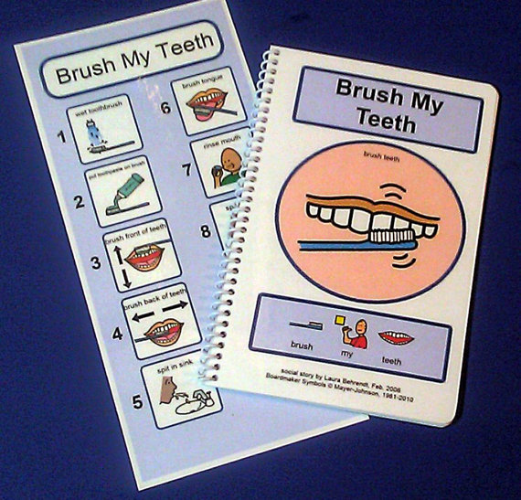
What is task analysis?
Breaking an activity or task into steps
Each step is a teachable component
Each step starts with a verb and is written succinctly in plain language
Data is collected and used to facilitate learning and increased independence by the learner

Slide 6
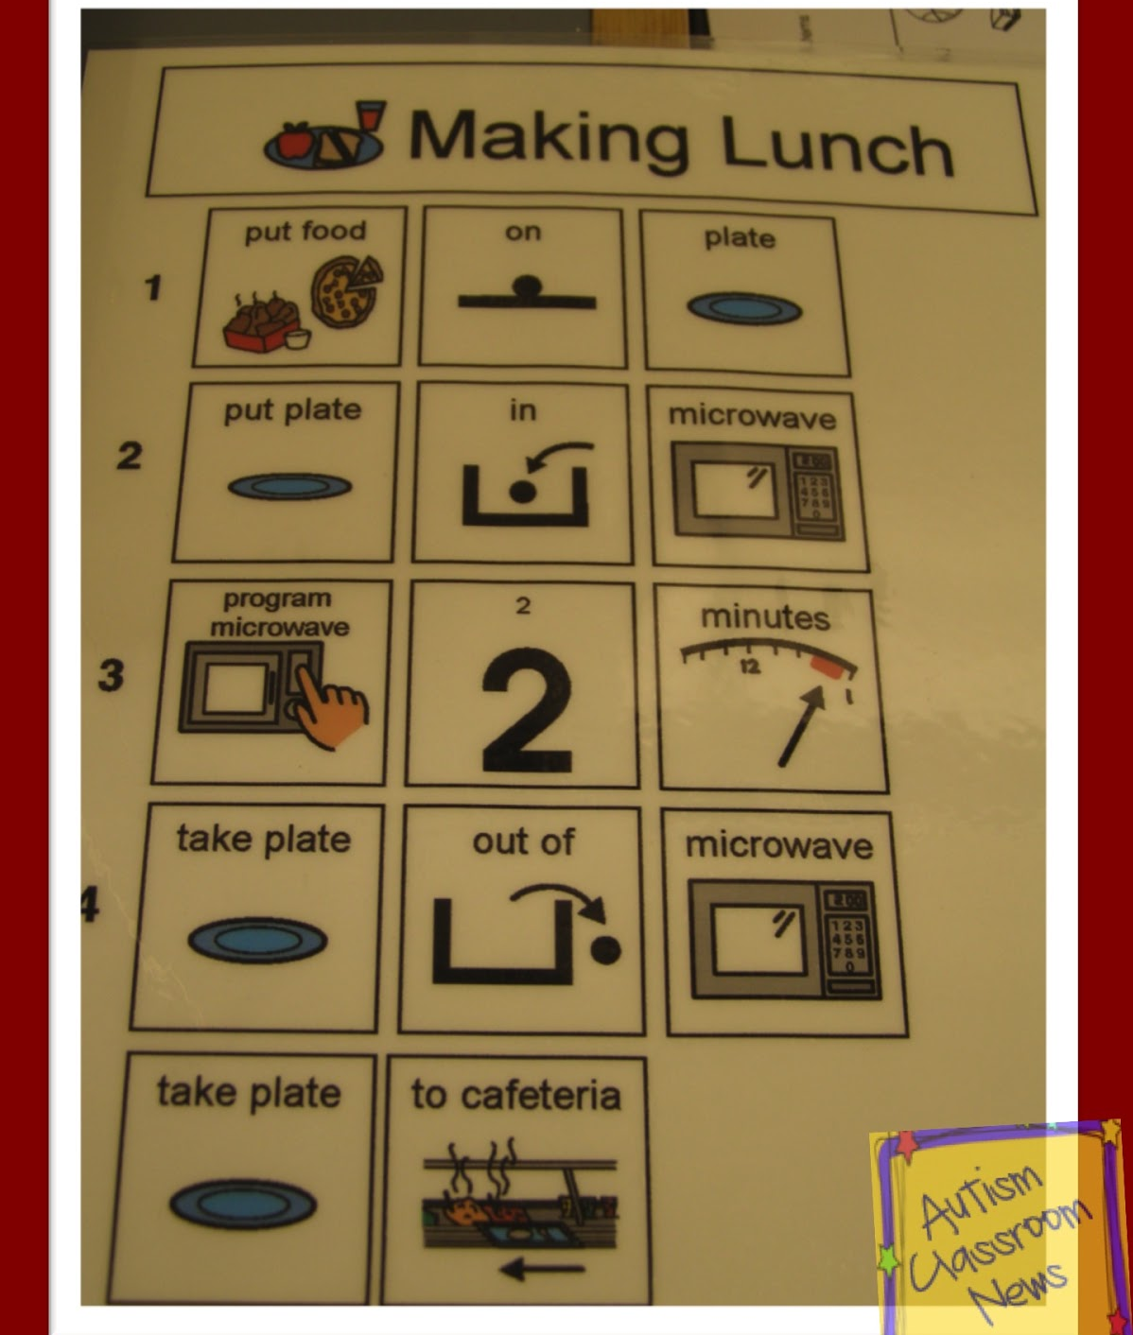
What is task analysis?
Includes what the learners does (content) and materials needed; as well as outlining what the instructor will be doing (process)
Examples:
Using a drink machine
Purchasing food at a fast food restaurant
Participating in a literacy lesson

Slide 7
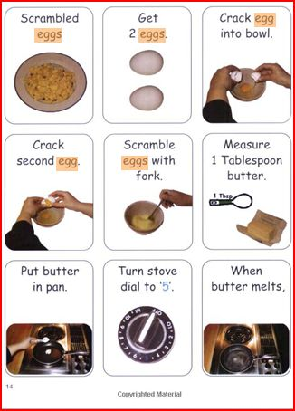
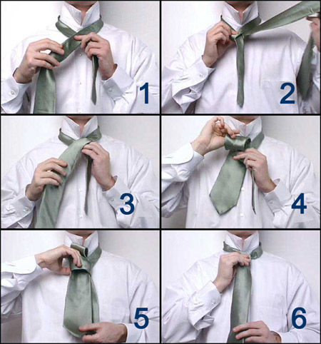
Step-by-step using photos

Slide 8
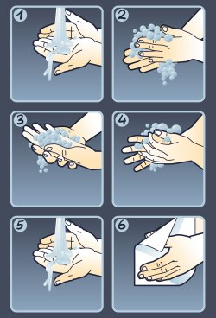
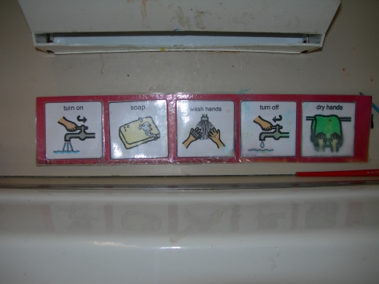
Commercial posters or symbols

Slide 9
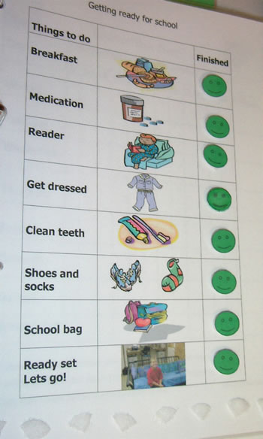
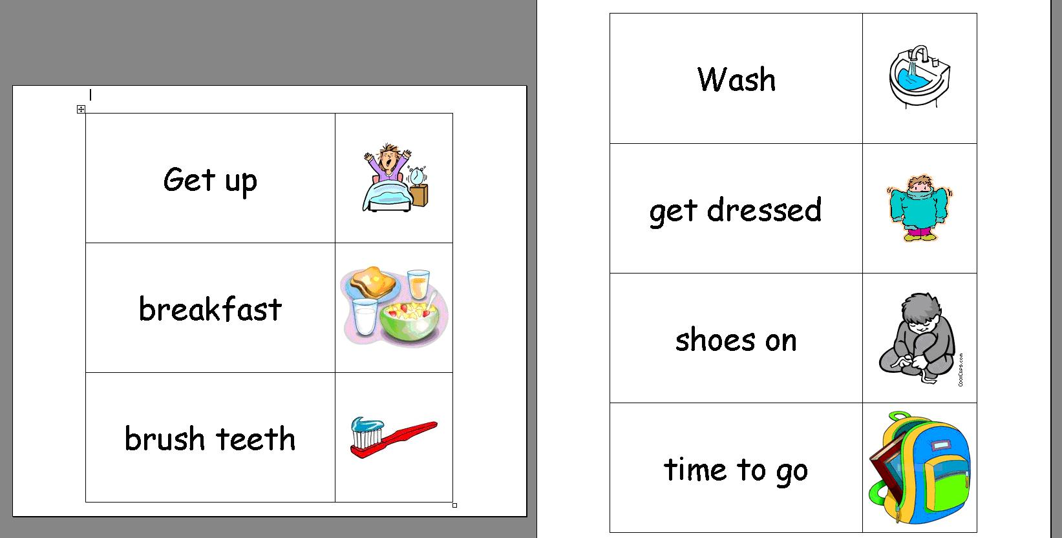
Visual Supports

Slide 10
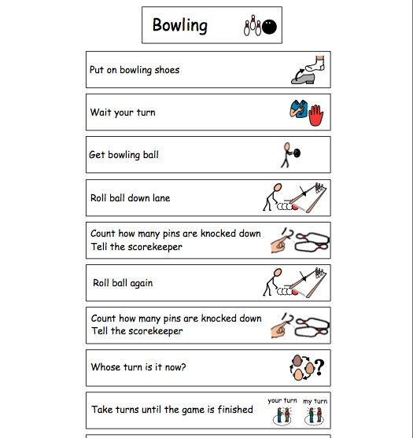
Task Analyzing
Individualized
Ways to figure out the steps:
Think about how you would do it (remembering the steps will be sequenced the way that the learner needs the steps, your way is not the only way to do an activity)
Watch a student / person who has mastered the activity

Slide 11
Ecological Inventory
The identification and comparison of an individual’s current skills and desired skills
Identifies skills and / or adaptations necessary to move form the present level of functioning to the desired level of functioning
A form of authentic assessment
Provides information about materials and processes to support learning – part of the planning / organizing / assessment stage for instruction
Helps determine the sequence and number of steps (chunk or slice steps)

Slide 13
Activity: Creating a task analysis
Select an everyday task that you are familiar with
Tasks can be a home, job, craft, sport/game or academic activity
Develop a task analysis: think about the sequence, chunking or slicing steps
When finished give to a classmate (remember a task analysis will be used by more than one person and all will need to understand it in order for there to be consistent instructional support)

Slide 14

Recording Data
Record each step of the task analysis as correct or incorrect
Record the level of prompting that is provided to the student for each step of the task analysis
Graph progress toward the goal

Slide 15
Recording Data: purchasing snack at school snack bar
Steps | + / - | Prompts
Gather items | + | I
2. Walk from class to snack bar | - | VP
3. Wait in line | + | I
4. Scan snack items | - | VP
5. Request desired items | - | G
6. Hand money envelope to worker | - | PP

